Slide 1
Course outline
Industry 4.0 + Quality Management = Quality 4.0
Industry 4.0
Quality 4.0
Quality Management
What is industry 4.0?
Industrial revolution
Key technologies of industry 4.0
The impacts of Industry 4.0
  What is Quality 4.0?
  How smart factory reduces costs of quality
  Case study: Future Factory
What Industrial revolution is Quality?
What is Quality Management?
Juran's Quality Trilogy
Cost of quality

Slide 2
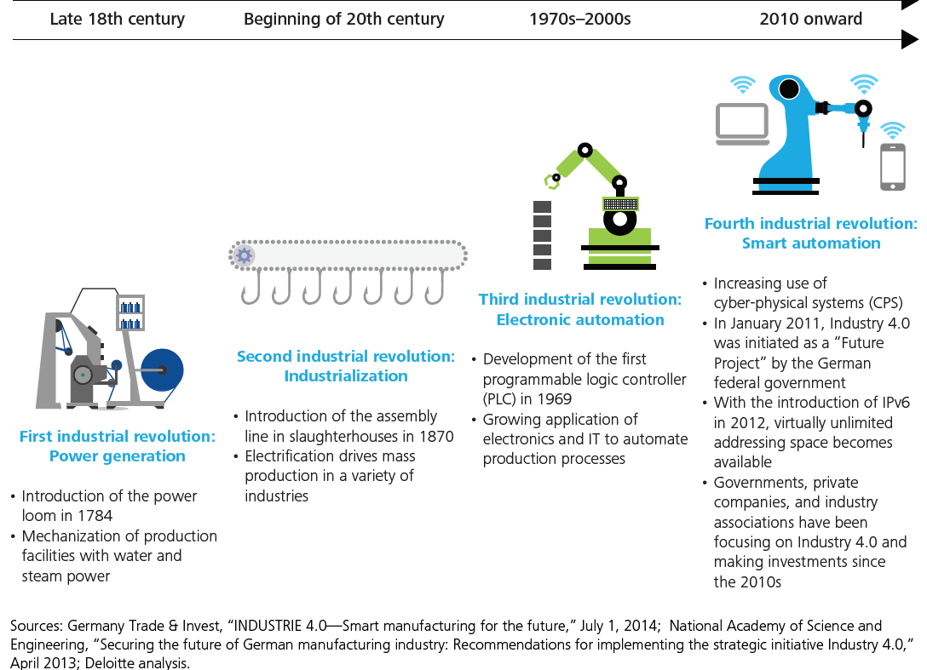
Industrial 4.0 and Industrial revolution
“Industry 4.0 connects embedded system production technologies and smart production processes to pave the way to a new technological age which will radically transform industry and production value chains and business models.”
—Germany Trade and Invest
Germany Trade & Invest, “Smart manufacturing for the future,” http://www.gtai.de/GTAI/Content/EN/Invest/_SharedDocs/Downloads/GTAI/Brochures/Industries/industrie4.0-smart-manufacturing-for-the-future-en.pdf; National Academy of Science and Engineering, “Securing the future of German manufacturing industry: Recommendations for implementing the strategic initiative Industry 4.0”

Slide 3
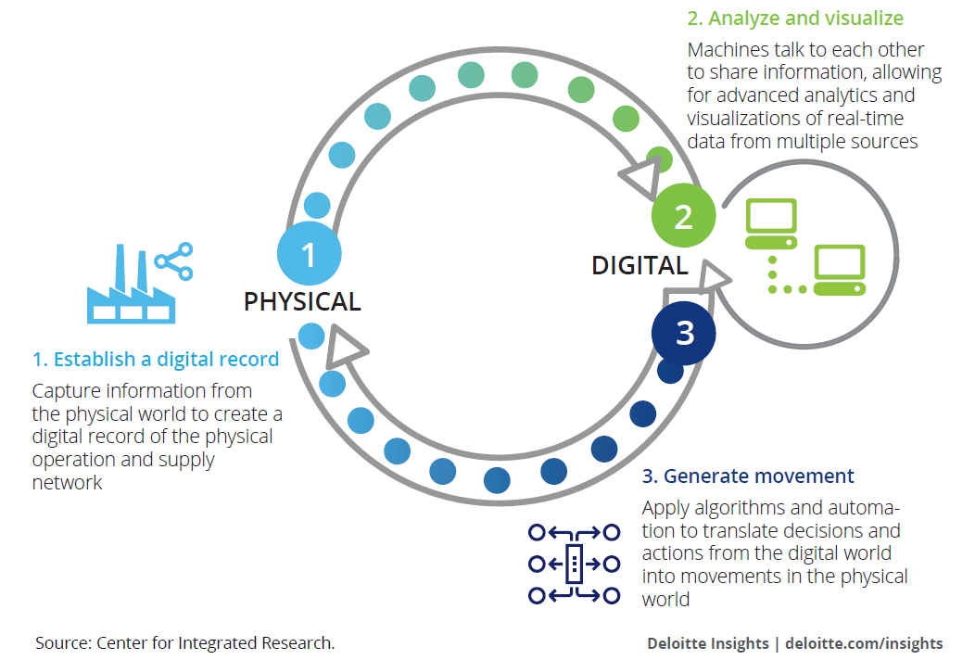
Transformation and Integration of digital information
Shifting to real-time access to data and intelligence will fundamentally transform the way to conduct business.
This shift is driven by the continuous and cyclical flow of information and actions between physical and digital worlds called ‘The Physical-to-Digital-to-Physical (PDP) loop’
Source: Forces of change: Industry 4.0
A Deloitte series on Industry 4.0
Notes:
To achieve this process, Industry 4.0 combines relevant physical and digital technologies, including analytics, additive manufacturing, robotics, high-performance computing, natural language processing, artificial intelligence and cognitive technologies, advanced materials, and augmented reality → The nine technologies for industry 4.0

Slide 4
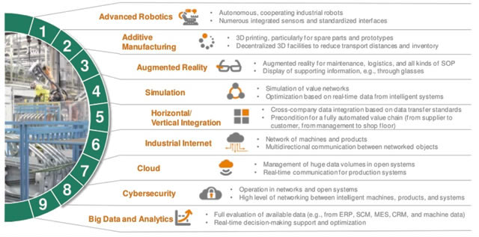
The Nine Pillars of Technological Advancement of Industry 4.0
Source: Boston Consulting Group

Slide 5
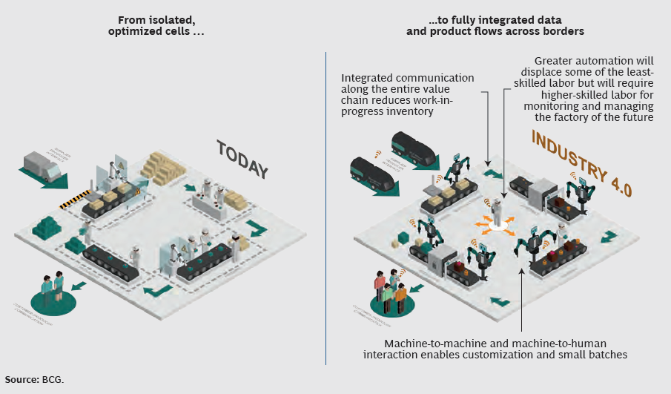
Changing Traditional Manufacturing to Smart Factory
With industry 4.0, the nine pillars of technological advancement will transform production
From isolated, optimized cells to a fully integrated, automated and optimized production flow, leading to great efficiencies and changing traditional production relationships among suppliers, producers and customer – as well as between human and machine

Slide 6
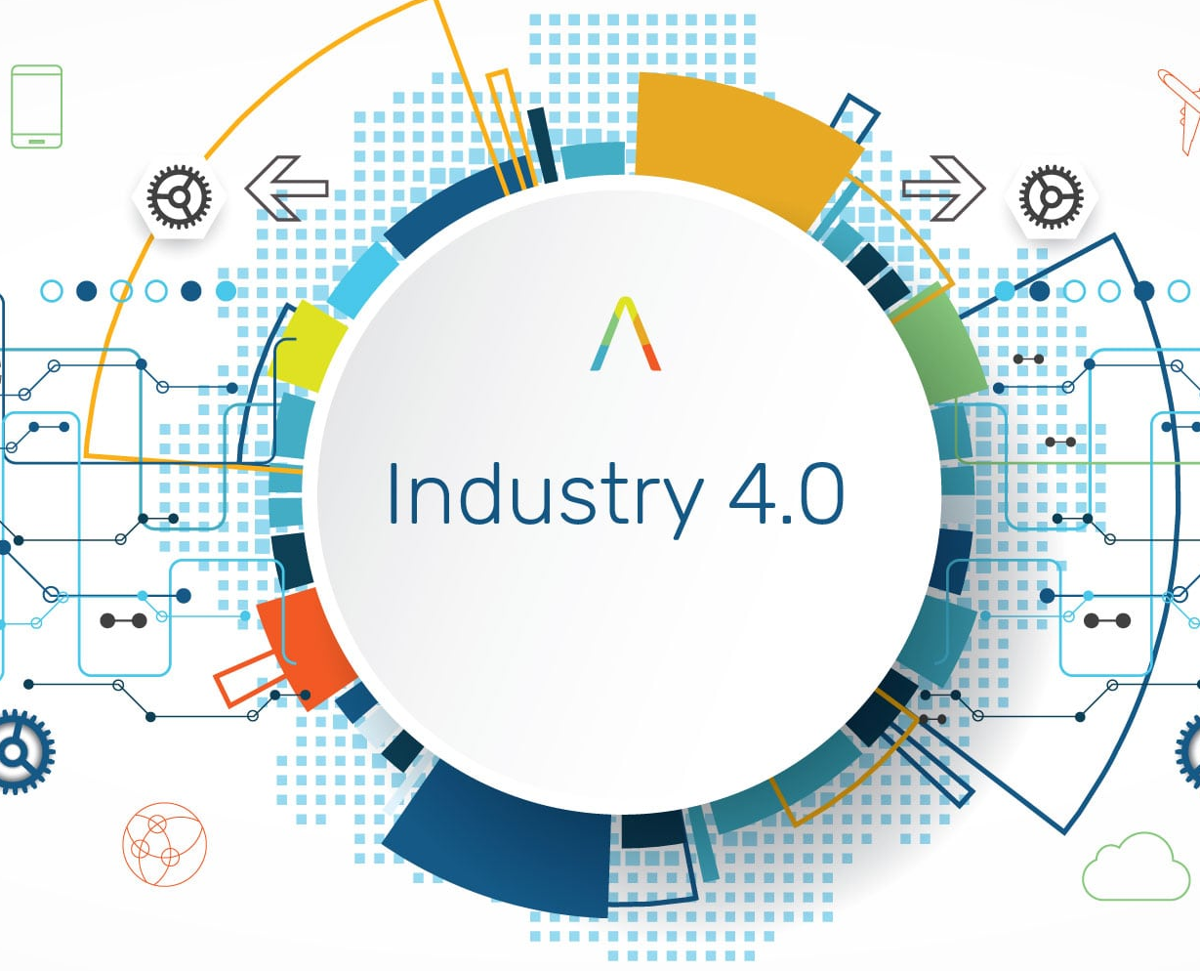
Class discussion
Why does Industry 4.0 matter in this era?

Slide 7
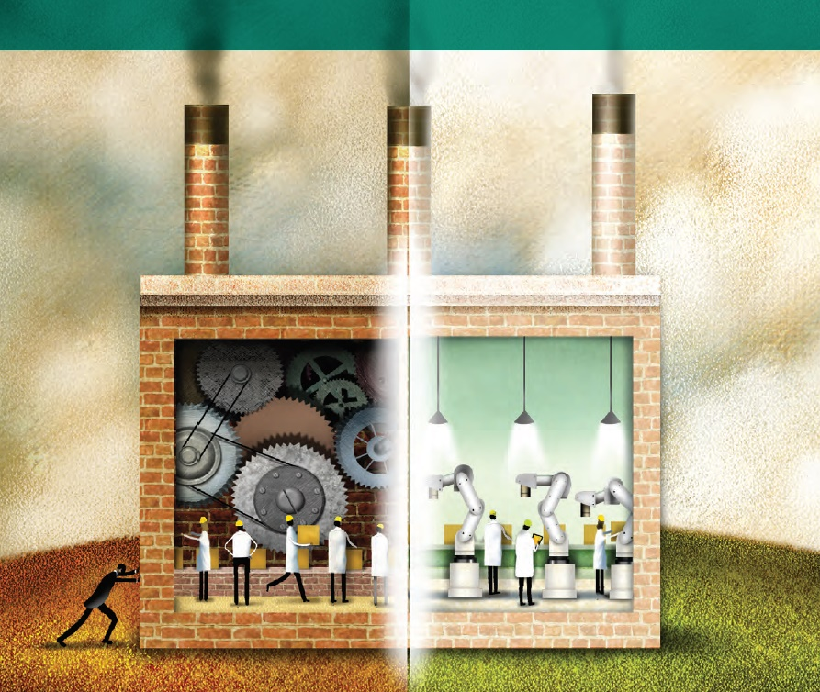
Why does Industry 4.0 matter?
“Industry 4.0 touches everything in our daily lives”
“It’s not just about the supply chain or manufacturing–it’s about business operations
and revenue growth”
“Industry 4.0 integrates the digital and physical worlds”
Source: Forces of change: Industry 4.0
A Deloitte series on Industry 4.0
Notes:
1. “Industry 4.0 touches everything in our daily lives”
I4.0 does not just touch ‘manufacturers’ but all of us
I4.0 will change how we make things but it could also affect how those things are moved, how customer interact with them and the experience they expect to have as they interact with companies
Beyond that, it could drive changes in the workforce, requiring new skills and roles.
Good example: this is the reason why we have to study this course!
2. “Industry 4.0 integrates the digital and physical worlds
- Beyond the digital thread, the use of the digital twin can enable organizations to gain insight into the inner workings of systems or facilities, simulate possible scenarios, and understand the impacts of changes in one node on the rest
of the network.
3. It’s not just about the supply chain or manufacturing–it’s about business operations and revenue growth
I4.0 is broader than just supply chain or production: Industry 4.0 capabilities can improve business operations and revenue growth, transforming products, the supply chain, and the customer experience.
Impact on product: transform the way products are designed and developed. Lead to business model.
Impact on supply chain: I4.0 enables the smart factory, connect supply network and logistics capabilities and inform planning and inventory processes
Impact on customers: enhance the customer experience, direct selling and marketing strategies though data gathered though intelligent products and services. Customers can interact with the object.

Slide 8
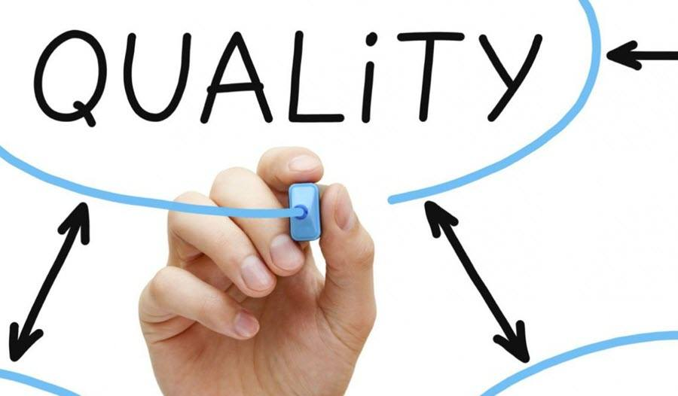
What is Quality?
Definition of quality
Conformance to specification (British Defense Industries Quality Assurance Panel)
Conformance to requirements (Philip Crosby)
Fitness for purpose or use (Juran)
A predictable degree of uniformity and dependability, at low cost and suited to the market (Edward Deming)
Meeting the (stated) requirements of the customer- now and in the future (Mike Robinson)
The totality of features and characteristics of a product or service that bears on its ability to satisfy stated or implied needs (ISO 8402)
degree to which a set of inherent characteristics fulfils requirement (ISO 9000)

Slide 9
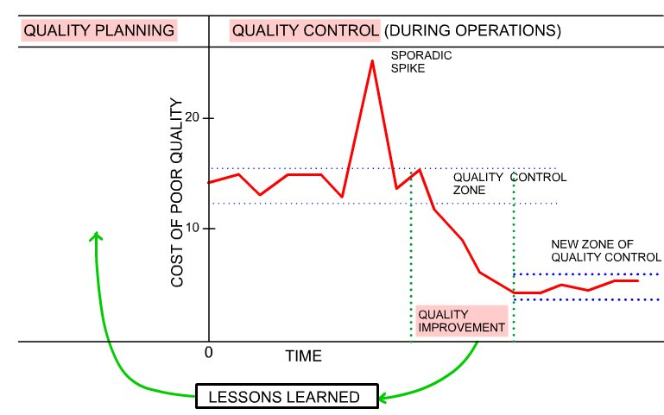
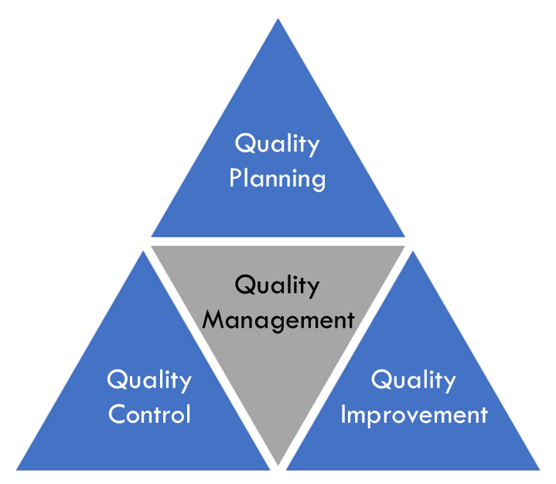
Quality Management: Juran’s Quality Trilogy
Quality Management According to Juran consisted of three basic processes called ‘Juran’s Trilogy’
Quality Planning is the activity of developing the products and processes required to meet customer’s needs.
Quality improvement aims to attain levels of performance that are
unprecedented—levels that are significantly better than any past level.
Quality control is the process used by operational personnel to ensure that their processes meet the product and service requirements.

Slide 10
Cost of Quality
Quality costs are those incurred in excess of those that would have been incurred if the product were built or the service performed exactly right the first time
Prevention cost
The costs of all activities specifically designed to prevent poor quality in products or services.
The costs associated with measuring, evaluating, or auditing products or services to assure conformance to quality standards and performance requirements.
Appraisal cost
Internal failure cost
Failure costs occurring prior to delivery or shipment of the product, or the furnishing of a service, to the customer.
External failure cost
Failure costs occurring after delivery or shipment of the product, and during or after furnishing of a service, to the customer.
Source: Juran's Quality Handbook: The Complete Guide to Performance Excellence

Slide 11
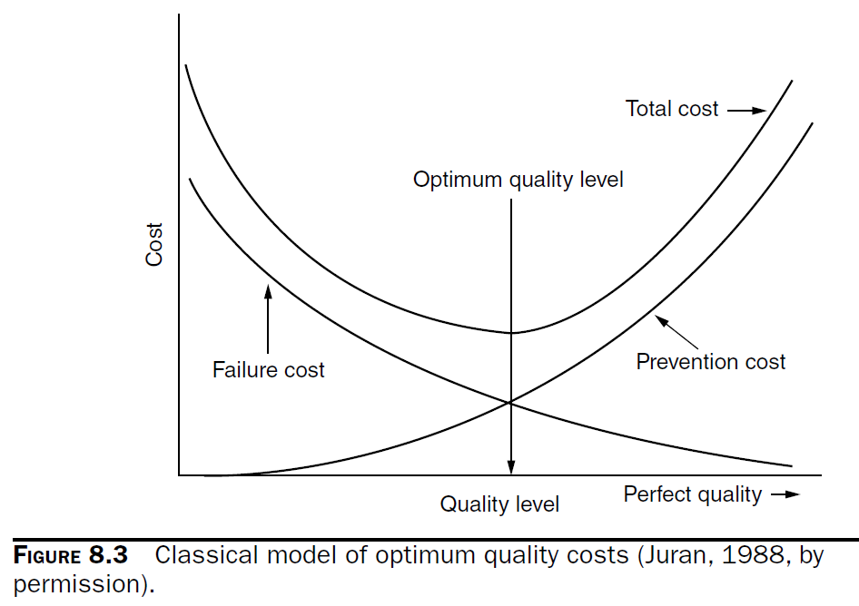
Cost of Quality
Source: Juran's Quality Handbook: The Complete Guide to Performance Excellence

Slide 12
Why Cost of Quality really matters
Costs of quality are the most difficult to measure (December 2016 Intelex Quality Survey)
Investing in Quality will give high return in revenue and profit

Slide 13
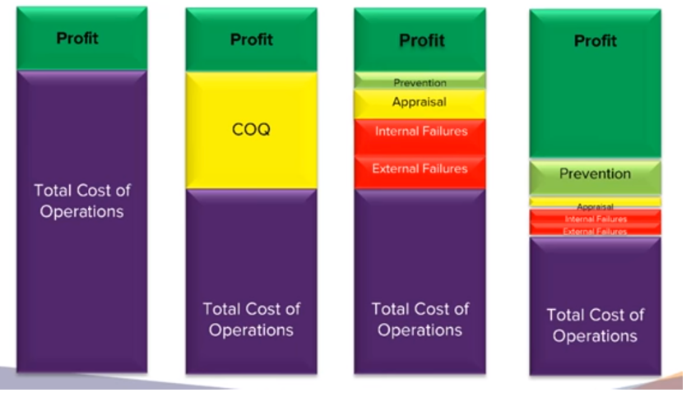
What is Quality 4.0?
Quality 4.0 certainly includes the digitalization of quality management. More importantly it is the impact of that digitalization on quality technology, processes and people.
With Quality 4.0, firm can earn more profit and reduce cost, especially internal and external failure cost
Global manufactures expect digitization will help them increase annual revenues by 2.9% while reducing costs by 3.6% (PwC 2016 Global Industry 4.0 Survey)
Productivity increases of 4%-5% per year
Quality improvements that result in defects being cut by 50%
On-time delivery increases from 82%-98%
(Rockwell Automation)

Slide 14

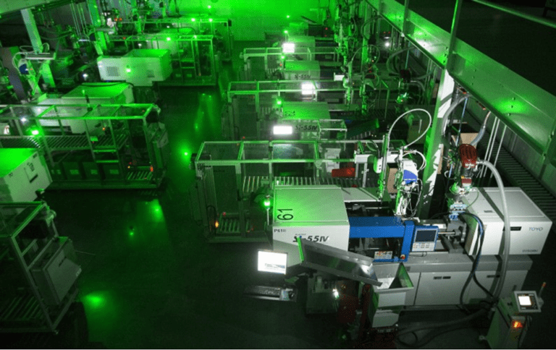
Future Factory: How Technology Is Transforming Manufacturing
Case study: FANUC, the Japanese robotics company
Operating a “lights-out” factory since 2001, where robots build other robots completely unsupervised for nearly a month at a time.
The factory is outfitted with 20 industrial robots that can pick, pack, and transfer packages with no human presence or oversight.
Without robots, it would take as many as 500 workers to fully staff this 40K square foot warehouse — instead, the factory requires only five technicians to service the machines and keep them working.
Source: https://www.cbinsights.com/research/future-factory-manufacturing-tech-trends/#quality

Slide 15
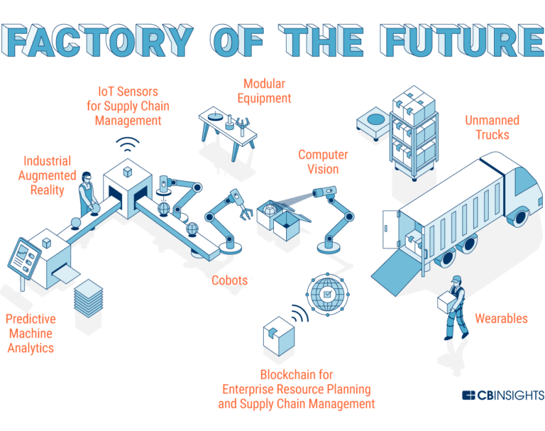
Future Factory: How Technology Is Transforming Manufacturing
8 different steps of the manufacturing process to Future Factory
Go to https://www.cbinsights.com/research/future-factory-manufacturing-tech-trends/#quality
Notes:
Go to https://www.cbinsights.com/research/future-factory-manufacturing-tech-trends/#quality)

Slide 16
Role-play
Arrival of Industry 4.0 Era: What should we do next?
Source: https://www.i-scoop.eu/manufacturing-industry/?fbclid=IwAR2k2T9_YyxroWoUS-EBa5U7k1QjYRfuMHPwRUOrxLBdHuGDu_sF8ywtXeY

Slide 17

The arrival of Industry 4.0: What should we do next?
Due to the arrival of industry 4.0, a young and new CEO of Company A is worried if the company will not be able to compete with the competitors in the market. He then has as a new vision to transform the existing operation to be smart factory.
Smart factory is the key!
But how can my people think like me?
CEO
Notes:
Situation: Due to the arrival of industry 4.0, CEO of Company A has a new vision to transform the existing operation to be smart factory in response to industry 4.0 and competing with the competitors. However, the main concern is that the company staff are still lack of industry 4.0 awareness. CEO hence decides to organize a meeting with the representatives from all departments to announce the new vision and create the awareness.

Slide 18

The arrival of Industry 4.0: What should we do next?
The young CEO then arranges the meeting with managers from all functions in the company. He explains why the company needs to respond to industry 4.0 to makes sure that everyone is on the same page.
Marketing manager
Production manager
Logistics and warehouse manager
Quality assurance manager
R&D manager
HR Manager
CEO
Group 1
Group 2
Group 3
Group 4
Group 5
Group 6

Slide 19
The arrival of Industry 4.0: What should we do next?
Now, it is your turn…
I want to hear your thought
What your function does
How important your function is in industry 4.0 era
How your function will respond to it
10 minutes for brainstorming and 3 minutes for presentation
CEO

